Slide 1
Using COM Components in C#
Click Me to Start …

Slide 2
- Agenda
How to create Excel file in C#
How to create Excel file in C# - Example
How to format an Excel file using C#
How to format an Excel file using C# - Example

Slide 3
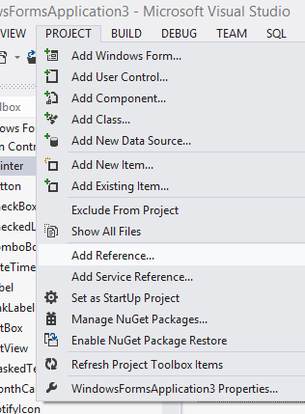
How to create Excel file in C#
Create a new project in your Visual Studio and add a Command Button to your C# Form.
Select Add Reference dialogue from Project menu of your Visual Studio

Slide 4
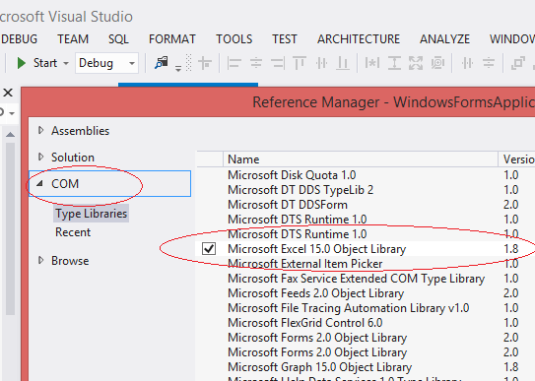
How to create Excel file in C#
Select Microsoft Excel 15.0 Object Library of COM left side menu and click OK button

Slide 5
How to create Excel file in C#
First we have to initialize the Excel application Object.
Excel.Application xlApp = new Microsoft.Office.Interop.Excel.Application();
Before creating new Excel Workbook, you should check whether Excel is installed in your system.
if (xlApp == null)
{
MessageBox.Show("Excel is not properly installed!!");
return;
}
Then create new Workbook
xlWorkBook = xlApp.Workbooks.Add(misValue);

Slide 6
How to create Excel file in C#
After creating the new Workbook, next step is to write content to worksheet
xlWorkSheet = (Excel.Worksheet)xlWorkBook.Worksheets.get_Item(1);
xlWorkSheet.Cells[1, 1] = "ID";
xlWorkSheet.Cells[1, 2] = "Name";
xlWorkSheet.Cells[2, 1] = "1";
xlWorkSheet.Cells[2, 2] = "One";
xlWorkSheet.Cells[3, 1] = "2";
xlWorkSheet.Cells[3, 2] = "Two";
Save Excel file (SaveAs() method)
xlWorkBook.SaveAs("your-file-name.xls");

Slide 7
How to create Excel file in C# - Example
using System;
using System.Windows.Forms;
using System.Runtime.InteropServices;
using Excel = Microsoft.Office.Interop.Excel;
namespace WindowsFormsApplication3
{
public partial class Form1 : Form
{
public Form1()
{
InitializeComponent();
}
private void button1_Click(object sender, EventArgs e)
{
Excel.Application xlApp = new Microsoft.Office.Interop.Excel.Application();
if (xlApp == null)
{
MessageBox.Show("Excel is not properly installed!!");
return;
}

Slide 8
How to create Excel file in C# - Example cont..
Excel.Workbook xlWorkBook;
Excel.Worksheet xlWorkSheet;
object misValue = System.Reflection.Missing.Value;
xlWorkBook = xlApp.Workbooks.Add(misValue);
xlWorkSheet = (Excel.Worksheet)xlWorkBook.Worksheets.get_Item(1);
xlWorkSheet.Cells[1, 1] = "ID";
xlWorkSheet.Cells[1, 2] = "Name";
xlWorkSheet.Cells[2, 1] = "1";
xlWorkSheet.Cells[2, 2] = "One";
xlWorkSheet.Cells[3, 1] = "2";
xlWorkSheet.Cells[3, 2] = "Two";
xlWorkBook.SaveAs("d:\\csharp-Excel.xls", Excel.XlFileFormat.xlWorkbookNormal, misValue, misValue, misValue, misValue, Excel.XlSaveAsAccessMode.xlExclusive, misValue, misValue, misValue, misValue, misValue);
xlWorkBook.Close(true, misValue, misValue);
xlApp.Quit();
Marshal.ReleaseComObject(xlWorkSheet);
Marshal.ReleaseComObject(xlWorkBook);
Marshal.ReleaseComObject(xlApp);
MessageBox.Show("Excel file created , you can find the file d:\\csharp-Excel.xls");
}
}
}

Slide 9
How to format an Excel file using C#
Excel Number Formatting
  Excel.Range formatRange;
  formatRange = xlWorkSheet.get_Range("a1", "b1");
  formatRange.NumberFormat = "#,###,###";
  xlWorkSheet.Cells[1, 1] = "1234567890";
Excel Date Formatting
    Excel.Range formatRange;
    formatRange = xlWorkSheet.get_Range("a1", "b1");
    formatRange.NumberFormat = "mm/dd/yyyy";
    //formatRange.NumberFormat = "mm/dd/yyyy hh:mm:ss";
    xlWorkSheet.Cells[1, 1] = "31/5/2014";
Bold entire row
    Excel.Range formatRange;
    formatRange = xlWorkSheet.get_Range("a1");
    formatRange.EntireRow.Font.Bold = true;
    xlWorkSheet.Cells[1, 5] = "Bold";

Slide 10
How to format an Excel file using C#
Add border to a specific cell
    Excel.Range formatRange = xlWorkSheet.UsedRange;
    Excel.Range cell = formatRange.Cells[3, 3];
    Excel.Borders border = cell.Borders;
    border.LineStyle = Excel.XlLineStyle.xlContinuous;
    border.Weight = 2d;
Border around multiple cells in excel
    Excel.Range formatRange;
    formatRange = xlWorkSheet.get_Range("b2", "e9");
    formatRange.BorderAround(Excel.XlLineStyle.xlContinuous,
    Excel.XlBorderWeight.xlMedium, Excel.XlColorIndex.xlColorIndexAutomatic,
    Excel.XlColorIndex.xlColorIndexAutomatic);
    Excel Cell coloring
Cell background color
Excel.Range formatRange;
    formatRange = xlWorkSheet.get_Range("b1", "b1");
    formatRange.Interior.Color = System.Drawing.
    ColorTranslator.ToOle(System.Drawing.Color.Red);
    xlWorkSheet.Cells[1, 2] = "Red";

Slide 11
How to format an Excel file using C#
Cell font color , size
    Excel.Range formatRange;
    formatRange = xlWorkSheet.get_Range("b1", "b1");
    formatRange.Font.Color
    System.Drawing.ColorTranslator.ToOle(System.Drawing.Color.Red);
    formatRange.Font.Size = 10;
    xlWorkSheet.Cells[1, 2] = "Red";
How to merge Excel cells
xlWorkSheet.get_Range("b2", "e3").Merge(false);

Slide 12
How to format an Excel file using C# - Example
using System;
using System.Windows.Forms;
using Excel = Microsoft.Office.Interop.Excel;
namespace WindowsFormsApplication1
{
public partial class Form1 : Form
{
public Form1()
{
InitializeComponent();
}
private void button1_Click(object sender, EventArgs e)
{
Excel.Application xlApp;
Excel.Workbook xlWorkBook;
Excel.Worksheet xlWorkSheet;
object misValue = System.Reflection.Missing.Value;
Excel.Range chartRange;
xlApp = new Excel.Application();
xlWorkBook = xlApp.Workbooks.Add(misValue);
xlWorkSheet = (Excel.Worksheet)xlWorkBook.Worksheets.get_Item(1);

Slide 13
How to format an Excel file using C# - Example cont…
//add data
xlWorkSheet.Cells[4, 2] = "";
xlWorkSheet.Cells[4, 3] = "Student1";
xlWorkSheet.Cells[4, 4] = "Student2";
xlWorkSheet.Cells[4, 5] = "Student3";
xlWorkSheet.Cells[5, 2] = "Term1";
xlWorkSheet.Cells[5, 3] = "80";
xlWorkSheet.Cells[5, 4] = "65";
xlWorkSheet.Cells[5, 5] = "45";
xlWorkSheet.Cells[6, 2] = "Term2";
xlWorkSheet.Cells[6, 3] = "78";
xlWorkSheet.Cells[6, 4] = "72";
xlWorkSheet.Cells[6, 5] = "60";
xlWorkSheet.Cells[7, 2] = "Term3";
xlWorkSheet.Cells[7, 3] = "82";
xlWorkSheet.Cells[7, 4] = "80";
xlWorkSheet.Cells[7, 5] = "65“;

Slide 14
How to format an Excel file using C# - Example cont…
xlWorkSheet.Cells[8, 2] = "Term4";
xlWorkSheet.Cells[8, 3] = "75";
xlWorkSheet.Cells[8, 4] = "82";
xlWorkSheet.Cells[8, 5] = "68";
xlWorkSheet.Cells[9, 2] = "Total";
xlWorkSheet.Cells[9, 3] = "315";
xlWorkSheet.Cells[9, 4] = "299";
xlWorkSheet.Cells[9, 5] = "238";
xlWorkSheet.get_Range("b2", "e3").Merge(false);
chartRange = xlWorkSheet.get_Range("b2", "e3");
chartRange.FormulaR1C1 = "MARK LIST";
chartRange.HorizontalAlignment = 3;
chartRange.VerticalAlignment = 3;
chartRange.Interior.Color = System.Drawing.ColorTranslator.ToOle(System.Drawing.Color.Yellow );
chartRange.Font.Color = System.Drawing.ColorTranslator.ToOle(System.Drawing.Color.Red);
chartRange.Font.Size = 20;
chartRange = xlWorkSheet.get_Range("b4", "e4");
chartRange.Font.Bold = true;
chartRange = xlWorkSheet.get_Range("b9", "e9");
chartRange.Font.Bold = true;

Slide 15
How to format an Excel file using C# - Example cont…
private void releaseObject(object obj)
{
try
{
System.Runtime.InteropServices.Marshal.ReleaseComObject(obj);
obj = null;
}
catch (Exception ex)
{
obj = null;
MessageBox.Show("Unable to release the Object " + ex.ToString());
}
finally
{
GC.Collect();
}
}
}
}

Slide 16
How to format an Excel file using C# - Example cont…
chartRange = xlWorkSheet.get_Range("b2", "e9");
chartRange.BorderAround(Excel.XlLineStyle.xlContinuous, Excel.XlBorderWeight.xlMedium, Excel.XlColorIndex.xlColorIndexAutomatic, Excel.XlColorIndex.xlColorIndexAutomatic);
xlWorkBook.SaveAs("d:\\csharp.net-informations.xls", Excel.XlFileFormat.xlWorkbookNormal, misValue, misValue, misValue, misValue, Excel.XlSaveAsAccessMode.xlExclusive, misValue, misValue, misValue, misValue, misValue);
xlWorkBook.Close(true, misValue, misValue);
xlApp.Quit();
releaseObject(xlApp);
releaseObject(xlWorkBook);
releaseObject(xlWorkSheet);
MessageBox.Show("File created !");
}

Slide 17
Using COM Components in C#
Questions ?

